Slide 1

Securely Communicating Over an IPv6 Network
Bart Dworak
IIT School of Applied Technology
bdworak@hawk.iit.edu
Doug Wilhelm
IIT School of Applied Technology
dwilhel1@hawk.iit.edu
Zeina Abdel Samad
IIT School of Applied Technology
zabdelsa@hawk.iit.edu
Olivia Minton
IIT School of Applied Technology
jcallana@hawk.iit.edu

Slide 2
Problem
Implementing an IPv6 network only
Using existing or virtualized hardware
Securing the IPv6 network
Using IPsec packet encryption
Observing IPv6 and IPSec traffic via Wireshark
With and without IPsec encryption

Slide 3
Resolution
Create an IPv6 hardware network
Using a router, servers, and laptop for documentation
Secure IPv6 network traffic
Using IPsec packet encryption
Trace IPv6 and IPSec to view network traffic and confirm implementation
Using Wireshark and a passive network splice

Slide 4


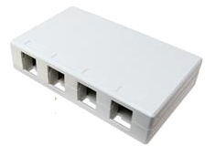
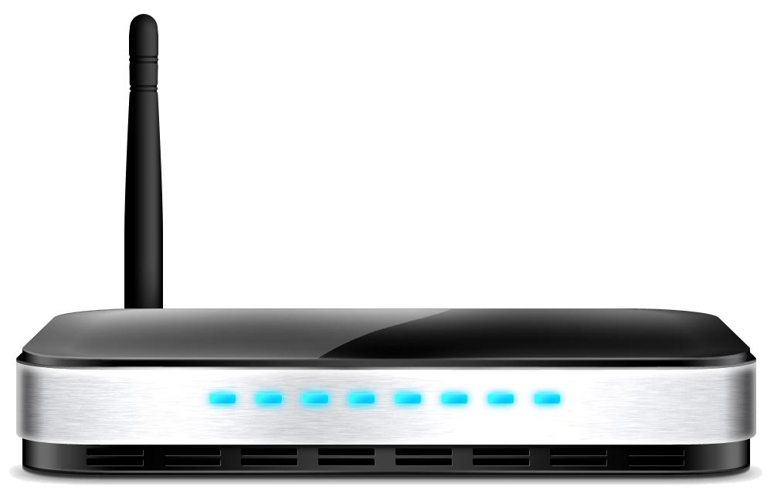
How System Works - Topology
Server 2
Server 1
Observer Computer / Hacker
Monitor Connection
Hardware Setup
(2) Servers
(1) Router
(1) Observer Laptop
(1) Passive Network Splice
Passive Network Splice
Router

Slide 5
How System Works - Structure
Servers
Two Asus home-built server units running Ubuntu; IPv6 Hosts
Router
Routes both IPv4 and IPv6 network packets through Cat5e cabling
Observer Laptop
Utilizes Wireshark software to capture and analyze network packets
Passive Network Splice
Routes network packets passively past the observer

Slide 6
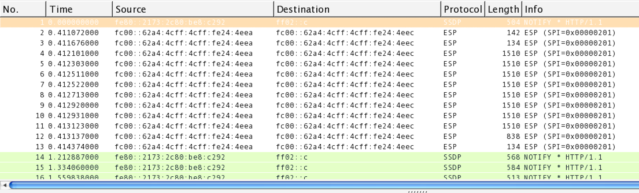
Proof of concept
IPSec web page request

Slide 7
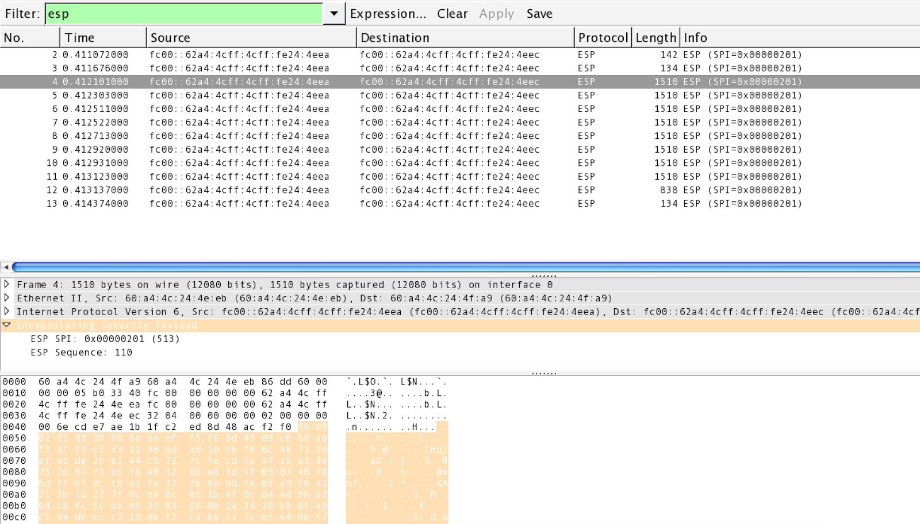
IPSec Web page request
ESP Payload
Data is encrypted

Slide 8
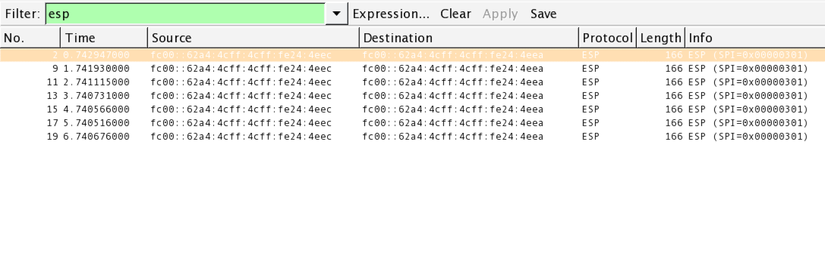
Proof of concept
]
IPSec encrypted ping

Slide 9
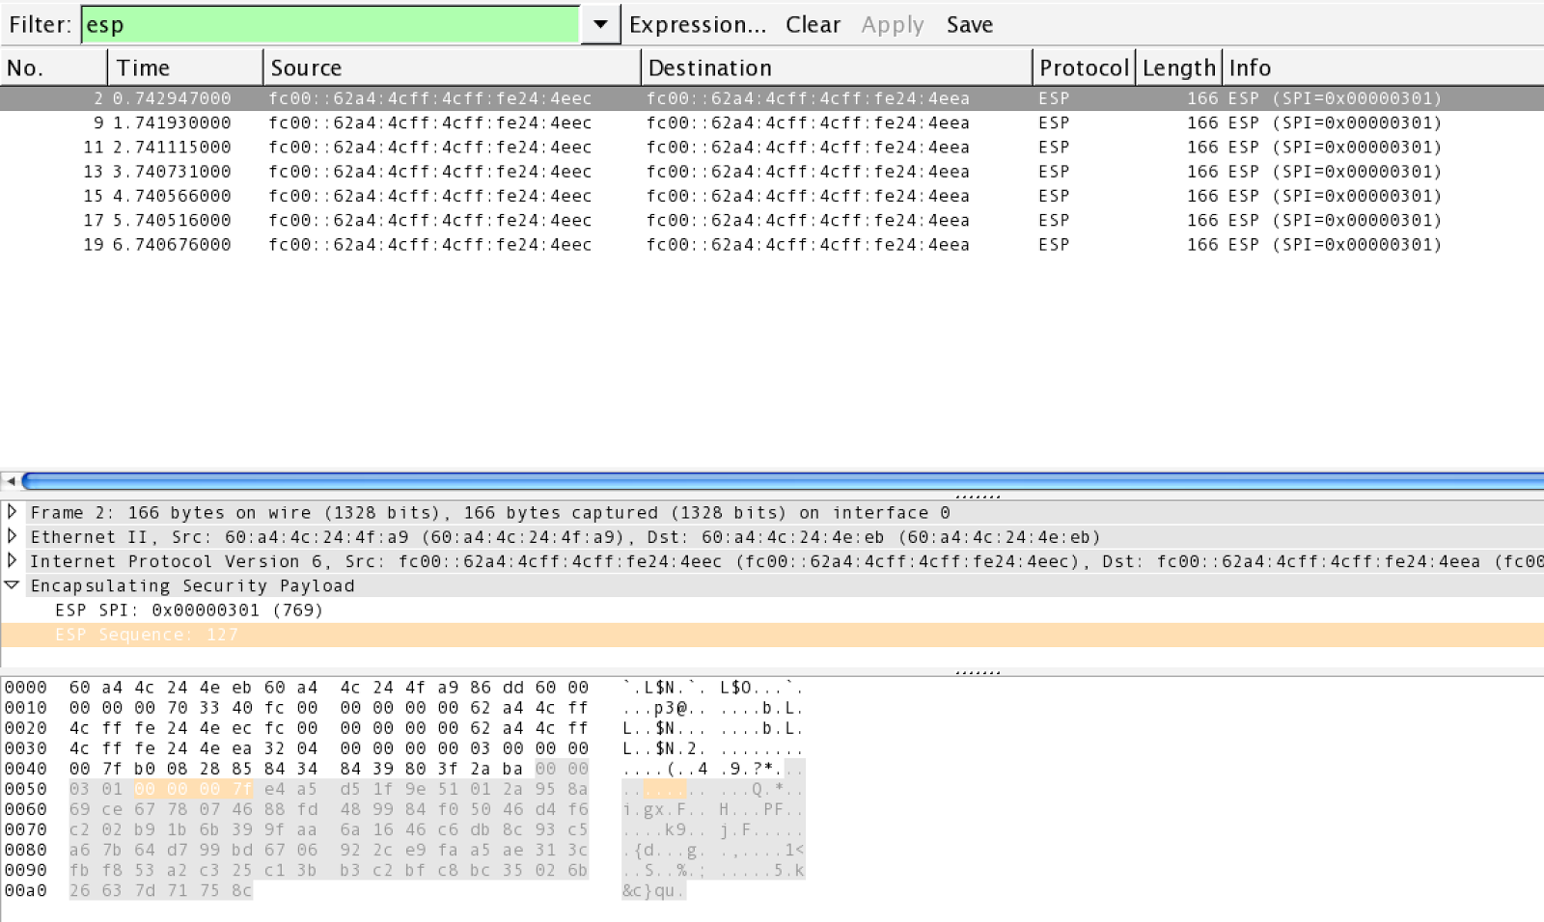
Proof of Concept
IPSec Encrypted ping
ESP Payload
Data is encrypted

Slide 10
Real World Implementation
Same System configuration was attempted on Azure Cloud
ESP Packets did not transverse the network
Setup was the same and packets were Filtered
Shows that even though technology exists(Since 1993!) it cannot be implemented everywhere.

Slide 11



Azure Cloud Topology
Ubuntu Server
Ubuntu Server
Azure US West Data Center
Azure US Central Data Center
Public Internet

